Slide 1


San Diego Gives 2026
Marketing Toolkit Overview
Day of Giving: September 17, 2026
Notes:
Overview of the San Diego Gives 2026 Marketing Toolkit.

Slide 2
PR & MEDIA GUIDELINES
Key Campaign Dates & Timeline
August 1
Start pre-launch promotion and early outreach to donors and sponsors
August 28
Full campaign kickoff
September 14
External media outreach cutoff
September 17
San Diego Gives Day of Giving
September 18–22
Thank-you campaign and stewardship
Notes:
Walk through the campaign timeline.

Slide 3
PR & MEDIA GUIDELINES
Background
San Diego Gives is a year-round program that promotes nonprofit sustainability and donor education. In 2026, efforts will culminate in an online, regionwide Day of Giving on Sept. 17.
Now in its sixth year, the program shines a light on local pressing needs and the impactful responses of our nonprofit community via robust communications, an interactive website, volunteer opportunities and an online crowdfunding campaign.
All funds raised during the Day of Giving remain in San Diego to bolster our region. Last year, $900,000 was raised for 111 nonprofits and thousands of donors were engaged, with many making first-time gifts.
2025 By the Numbers
$900,000
raised last year
111
nonprofits
Notes:
Give background on the San Diego Gives program.

Slide 4
PR & MEDIA GUIDELINES
Why This Matters
We're all excited to share the good work we do — but when it comes to media, it's important that our messaging is coordinated, consistent and timely. This guide helps us work together to represent San Diego Gives in the best light possible.
Notes:
Introduce the first major section.

Slide 5
PR & MEDIA GUIDELINES
Your PR Contact
Nuffer, Smith, Tucker Public Relations
Natalie DeAngelo Neal
Email: nd@nstpr.com
Phone: 609-947-2727
Notes:
Introduce the PR contact.

Slide 6
PR & MEDIA GUIDELINES
If You Receive a Media Inquiry
Related to San Diego Gives/Day of Giving
Via email or direct message
Via phone
Alert the PR team within 2 hours and forward the email thread with any additional information to Natalie at nd@nstpr.com.
Please let us know who from your organization may be available to potentially conduct the interview. NST will help facilitate scheduling the interview.
Get the reporter's name, outlet, deadline and nature of request.
You can say, “I am not directly coordinating media requests for San Diego Gives/Day of Giving but let me get you in contact with someone who is. They'll reach out to you shortly. Thank you!”
Forward the information gathered above to Natalie at nd@nstpr.com.
Notes:
Explain what to do when receiving a media inquiry.

Slide 7
PR & MEDIA GUIDELINES
Planning Your Own Outreach?
Great! Please let us know what your plans are. We'd love to collaborate. Please do not share any materials that incorporate San Diego Gives branding without review from our team.
–
For review, please share all materials with: Jim Davis (jim@ncphilanthropy.org) and Natalie Neal (nd@nstpr.com).
–
Allow 1 to 2 business days for review.
Please pause any dedicated San Diego Gives media outreach by Sept. 14, as NST will be pitching
Day of Giving news coverage.
Notes:
Guidance for organizations planning their own outreach.

Slide 8
PR & MEDIA GUIDELINES
A Few Important Reminders
01
You should not provide interviews or speak on behalf of San Diego Gives without prior approval.
02
You can certainly speak for your own organization in relation to the Day of Giving — just let us know if you do so!
03
In the event there is a crisis/emergency in relation to San Diego Gives or the Day of Giving, we encourage you to defer any incoming inquiries to NST.
Notes:
Key reminders for participating organizations.

Slide 9
Outreach Templates & Assets
Notes:
Section divider for outreach templates and assets.

Slide 10
OUTREACH TEMPLATES & ASSETS
San Diego Gives Logo
Use of the San Diego Gives logo in any outreach helps build recognition and creates a unified Day of Giving campaign across the region. If you incorporate any San Diego Gives branding into your materials, please share them with the PR team for review and approval before publishing.
Logos can be downloaded at: https://ncphilanthropy.org/sd-gives-marketing-kit/
Notes:
Explain use of the San Diego Gives logo.

Slide 11
OUTREACH TEMPLATES & ASSETS
Email Templates
We've created customizable email templates to help engage your audience before, during and after San Diego Gives. Personalize each email with your organization's voice, stories and impact to create meaningful connections.
Mailchimp/Constant Contact-friendly e-mail templates include:
–
Outreach to board members
–
Outreach to donors
–
Outreach to volunteers
–
Calls-to-action and employer matching prompts
Email templates can be downloaded at: https://ncphilanthropy.org/sd-gives-marketing-kit/
Notes:
Describe available email templates.

Slide 12
OUTREACH TEMPLATES & ASSETS
Sample Copy & Messaging
Take the guesswork out of promoting San Diego Gives with ready-to-use messaging designed to help you engage supporters at every stage.
Messaging templates include:
–
"Save the Date" announcements for the Day of Giving
–
Customizable press release
–
Social media content
–
Website blurbs and homepage banners
Messaging templates can be downloaded at: https://ncphilanthropy.org/sd-gives-marketing-kit/
Notes:
Describe available messaging templates.

Slide 13
Talking Points & FAQs
Notes:
Section divider for talking points and FAQs.

Slide 14
TALKING POINTS & FAQS
Why San Diego Gives Matters
San Diego Gives matters because it unites our region in a powerful show of local generosity and community pride. By highlighting and supporting the work of San Diego-based nonprofits, the campaign keeps donations local, strengthens organizations doing vital work and builds a culture of giving that uplifts every corner of our community. It's not just about raising funds — it's about investing in the place we all call home.
Notes:
Explain why San Diego Gives matters.

Slide 15
TALKING POINTS & FAQS
How to Speak with Donors & Community Members
When speaking with donors and community members about San Diego Gives, focus on its local impact and collective spirit. Explain that it's a countywide movement to support San Diego-based nonprofits doing essential work in our own neighborhoods. Emphasize that every donation stays local, directly benefiting causes they care about. Invite them to be part of something bigger — a day where generosity fuels real change right here at home.
Notes:
Guidance on speaking with donors and community members.

Slide 16
TALKING POINTS & FAQS
How to Communicate the Impact of San Diego Gives
100% Local Impact
Strength in Numbers
Every dollar donated supports nonprofits working right here in San Diego County.
In 2025, 111 nonprofits participated, raising $900,000 to power local missions.
Collaborative Power
Year-Round Value
San Diego Gives strengthens nonprofit visibility, encourages donor trust and creates opportunities for cross-sector collaboration.
Beyond fundraising, participating organizations benefit from educational workshops, peer networking and shared marketing tools.
Community Connection
San Diego Gives fosters a sense of belonging and empowers residents to make a direct difference in their own neighborhoods.
Notes:
Five ways to communicate the campaign's impact.

Slide 17
TALKING POINTS & FAQS
FAQs
Q: What is San Diego Gives?
A: San Diego Gives is a countywide fundraising campaign that shines a light on local nonprofits and encourages San Diegans to give where they live.
Q: Who can participate in San Diego Gives?
A: Only verified 501(c)(3) nonprofits serving San Diego County are eligible to participate in San Diego Gives, but there are a number of opportunities for San Diegans everywhere to support those organizations.
Q: When is the Day of Giving?
A: The 2026 Day of Giving is on Tuesday, Sept. 17.
Notes:
Answer common questions, part one.

Slide 18
TALKING POINTS & FAQS
FAQs (continued)
Q: Where does the money go to?
A: All donations go directly to the nonprofit(s) chosen by the donor — no percentage is taken by San Diego Gives for operating expenses.
Q: How can donors give on the Day of Giving?
A: Donors can give through the San Diego Gives online platform on or before Sept. 17.
Q: Is San Diego Gives just one day?
A: While the Day of Giving is just one day on Sept.17, the San Diego Gives campaign includes months of storytelling, education and engagement leading up to the big day.
Notes:
Answer common questions, part two.

Slide 19
TALKING POINTS & FAQS
Campaign Readiness Checklist
Do you have a dedicated San Diego Gives webpage?
Matching gift partner secured?
Staff/board briefed and ready?
Content scheduled through Sept. 17?
Thank-you plan in place?
Notes:
Campaign readiness checklist for organizations.

Slide 20
Donor Platforms & Marketing Support
Notes:
Section divider for donor platforms and marketing support.

Slide 21
DONOR PLATFORMS & MARKETING SUPPORT
Donor Platforms
A donor platform provides a central, secure and user-friendly space for supporters to learn about your mission and make donations with ease. It allows you to:
–
Track donor engagement
–
Share impact stories
–
Collect valuable data for future outreach
A good platform also builds trust by offering a professional experience, helping you reach more people and raise funds faster and more effectively. Simply put, it turns interest into action.
Notes:
What a donor platform provides.

Slide 22
DONOR PLATFORMS & MARKETING SUPPORT
Donor Platforms
NCPC and the San Diego Gives team are recommending the use of Spotlight as the preferred donor platform.
Spotlight is designed to support crowdfunding-style campaigns and offers tools that make it easy to tell your story, engage supporters and track your fundraising progress. You are welcome to use any platform your organization is currently using. The most important thing is that it works well for you and provides a smooth giving experience for your donors.
Notes:
Recommend Spotlight as the preferred donor platform.

Slide 23
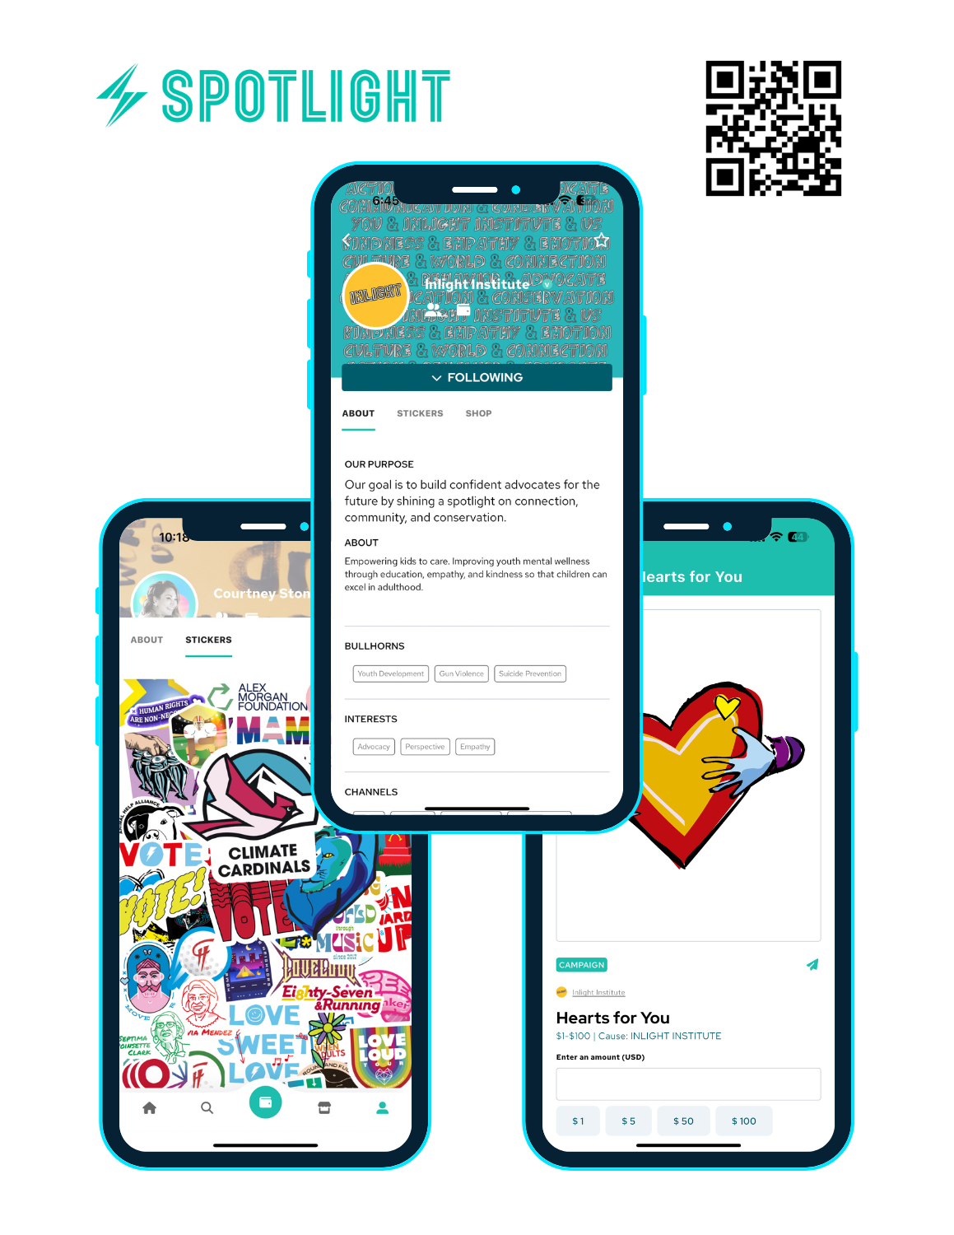
DONOR PLATFORMS & MARKETING SUPPORT
What You Get With Spotlight
Your Free SD Gives Spotlight Profile
As part of participating in San Diego Gives, Spotlight will create a free profile for your organization - making it easy for supporters to discover, follow, and donate throughout the campaign.
1
Free Organization Profile – Created for you (no subscription required))
2
Digital Giving Page – Ready for donations and storytelling
3
Social Sharing Tools – Campaign stickers and shareable content
4
Organization Dashboard – Track supporters and campaign activity
Notes:
Steps for organizations to get started on Spotlight.

Slide 24
DONOR PLATFORMS & MARKETING SUPPORT
Getting Started
Your SD Gives Setup- Getting started takes just a few minutes
–
Upload your organization logo HERE
–
We'll build your free organization profile
–
Create a free personal Spotlight account & we'll add you as an Organization Admin to see analytics
–
Your page is ready for SD Gives!
That's it. We'll handle the profile creation so you can focus on telling your story and raising support.
Notes:
Features of the Spotlight platform.

Slide 25
Marketing Toolkit for
Board Members
Notes:
Section divider for outreach templates and assets.

Slide 26
BOARD MEMBER TOOLKIT
Marketing Toolkit for Board Members
Getting your board involved in San Diego Gives can significantly strengthen your campaign and amplify your organization's reach. Board members are not only ambassadors of your mission — they're trusted voices in the community with networks that can help increase visibility, drive donations and build momentum.
Whether it's sharing your campaign on social media, making a personal gift or reaching out to their contacts, encouraging board engagement turns your Day of Giving into a powerful, collective effort.
Notes:
Introduce the board member marketing toolkit.

Slide 27
BOARD MEMBER TOOLKIT
Marketing Toolkit for Board Members
Empower your board members to leverage their networks and advocate for donations to your organization during the San Diego Gives fundraising campaign, showcasing their volunteer board service as a form of philanthropy.
–
Discuss San Diego Gives during an upcoming board meeting.
–
Include reminders of San Diego Gives in any board correspondence.
–
Assign board members light fundraising goals for the campaign.
–
Work with board members on their written communications.
–
Encourage participation!
Notes:
Actionable ways to engage board members.

Slide 28
BOARD MEMBER TOOLKIT
Marketing Toolkit for Board Members
We've created customizable email templates to help engage your audience before, during and after San Diego Gives. Personalize each email with your organization's voice, stories and impact to create meaningful connections.
Mailchimp/Constant Contact-friendly e-mail templates include:
–
Outreach to board members
–
Outreach to donors
–
Outreach to volunteers
–
Calls-to-action and employer matching prompts
Email templates can be downloaded at: https://ncphilanthropy.org/sd-gives-marketing-kit/
Notes:
Email templates for board member outreach.

Slide 29
BOARD MEMBER TOOLKIT
Sample Introduction Letter to Your Board
Dear [Board Member Name],
We're excited to share that [Organization Name] is once again participating in San Diego Gives, a countywide day of giving that celebrates and supports local nonprofits like ours. This year's event takes place on Thurs., Sept. 17, and we need your help to make it our most successful campaign yet.
As a valued board member, your voice and leadership make a big difference. Here are a few simple ways you can support our campaign:
–
Make an early gift to help us build momentum
–
Share our campaign with your personal and professional networks
–
Post on social media using the San Diego Gives hashtag and campaign graphics
–
Encourage others to give by highlighting why our mission matters
Your involvement in the campaign is invaluable to our success. Together, we can make a meaningful difference in the lives of those in need and strengthen the fabric of our community. Thank you for your continued support and dedication to our mission.
Please let us know how you'd like to be involved, and don't hesitate to reach out with questions or ideas.
Cont. next slide
Notes:
Sample introduction letter to the board, part one.

Slide 30
Sample Intro Letter Cont.
Campaign Overview: The San Diego Gives campaign aims to showcase the diverse faces of philanthropy and inspire others to join us in giving back to our community. As a valued member of our board, you play a crucial role in driving donations and spreading awareness of the San Diego Gives campaign.
Marketing Toolkit:
Social Media Graphics
Personalized Messages
Shareable graphics and messages are available to encourage your network to join you in supporting local nonprofits or a specific nonprofit important to you.
Craft personalized messages explaining why you're passionate about supporting the San Diego Gives campaign and how donations can make a difference in the lives of San Diegans. Share these messages via email, social media or personal conversations with your contacts.
Fundraising Events
Matching Gifts
Host virtual or in-person fundraising events to engage your network and encourage donations. You could organize a virtual happy hour, a charity run or a community service project to raise funds and awareness for the campaign.
Consider offering a matching gift challenge to incentivize donations from your network. For example, you could pledge to match donations up to a certain amount, doubling the impact of each contribution.
Sincerely,
[YOUR NAME]
[ORGANIZATION]
Notes:
Campaign overview and marketing toolkit details for board members.

Slide 31
Thank You!
You now have the tools to build awareness, engage your supporters and maximize your impact during San Diego Gives.
As you prepare for the Day of Giving, remember that the San Diego Gives team is here to support you every step of the way.
We can't wait to see the impact you'll make.
Need help?
Email: jim@ncphilanthropy.org
Notes:
Thank the audience and provide contact info.

