Slide 1
United Way of San Diego County North County Philanthropy Council
February 1, 2019

Slide 2
Getting Started
Introductions
When you think about United Way what one word comes to mind?

Slide 3
Presentation Goals
Outline our alignment, announcement & action framework
UWSD Mission, Vision, Role, Work
Areas of Focus
Business Connection
Messaging Feedback

Slide 4
Alignment
February:
Community Salons
Sr. Staff Retreat
Board approves final messaging
March:
Board Resource Retreat
Budget Development – Reality Strikes!
May – Announcement
May 1 – Community Breakfast
Board Approves FY20 Budget
ACTION

Slide 5
III. Vision, Mission and Strategy includes our role and areas of focus

Slide 6
VISION
United Way envisions a vibrant community built on opportunity for everyone.
MISSION
To spark breakthrough community action that elevates every child and family toward a brighter future.

Slide 7
2019
OUR ROLE
Unite the Community for Greater Impact
Create a Philanthropic Marketplace

Slide 8
Unite the Community
STRATEGIC FRAMEWORK
Analyze & Build Collaborative Transform
Query Data Action Networks Shared Systems

Slide 9
Details on “How” We Do This
Backbone
Data analysis
Convene cross-sectional representatives
Continuous learning/action
Take tools/learning to scale

Slide 10
Philanthropic Marketplace
STRATEGIC FRAMEWORK
Diversify ways business, individuals, and others give

Slide 11
Workplace Giving Campaigns
Small Business Development
Integrating Services

Slide 12
San Diego County Economic & Educational Impacts
San Diego County is facing Talent shortages.
San Diego County is becoming less competitive – it is becoming a less attractive place to do business.
Serious minority achievement gaps – 8/10 students are on track to succeed vs. only 3/10.
Innovation economy presents new challenges for future growth.
Demand for new skills, while gaps in educational attainment persist.

Slide 13
Early Childhood Success
Problem:
½ of San Diego’s 4 year olds are not attending pre-school, which means they are starting kindergarten at a disadvantage.
Problem:
In 2016, 49% of our County’s 3rd graders weren’t reading at grade level. They are 4x less likely to finish high school on time.

Slide 14
Youth Success
Problem:
In some of our communities, over 20% of students aren’t graduating on time, and some never catch up.
Problem:
By some estimates, over 60% of jobs now require some level of post-secondary education.

Slide 15
Family Stability
Problem:
More than 423,000 individuals in San Diego County (nearly 14% of its 3.1 million residents) are “food insecure.”
Problem:
30% of children raised in poverty do not finish high school.

Slide 16
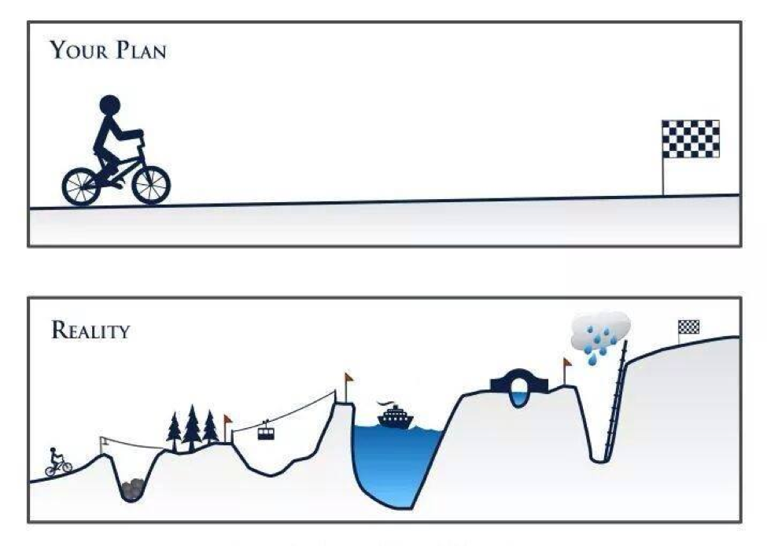
The Pathway

Slide 17
United Way Challenge
Increase our impact:
From hundreds of kids
to hundreds of thousands of kids
and their families

Slide 18
V. Messaging: Getting the Word Out
Identified Problem
How might the United Way listen to the community, understand what they say, and creating clarity in who we are, what we do and who we help in the community.
Identified Resource
Kevin Popovic, The Idea Guy™

Slide 19
Update: Community Listening
Research
Overall, United Way San Diego County had positive references across the internet.
Great variance in “what they did”, and “who they helped,” with little mention of partner organizations.
Survey
Webinars
Interviews
Notes:
We executed research, as well as community surveys distributed via email, social media and websites. We hosted (3) webinars, and interviewed people based on the (16) personas (different types of people) we work with in our community.

Slide 20
Update: Community Listening
How they learn about us:
Word of Mouth (73%)
Social Media (59%)
Events (57%)
Email (54%)
Websites (52%)
Workplace (51%)
Notes:
These are the channels, vehicles and programs they prefer to receive information, which directs us to look at utilizing these to reduce the barrier to communication.
These in bold are represented on other lists of preferences, as well.

Slide 21
Update: Community Listening
How familiar are you with the goals of UWSD?
One of every four doesn’t know our goals, and 2 of every 5 really aren’t sure.
Does UWSD offer easy to find critical information about the organization?
60% of respondents (donors) don’t think information is easy to find. (Accessibility)
How much trust do you have in UWSD in accomplishing its goals?
66% of respondents (2 out of 3 donors) don’t have trust in UWSD will accomplish its goals.
Notes:
When it came to the messaging within the communications, we learned even more.

Slide 22
Update: Community Listening
Reframed (updated) Problem Statement
How might United Way of San Diego County communicate to its unique audiences in a way that is easily accessible (or delivered directly), educates and builds trust?

Slide 23
Be clear in our focus
Articulate what we do in order for everyone to understand UWSD
Demonstrate our relationship to the people we work with
Share stories of working with partners to achieve outcomes
Education
Accessibility
Trust
Utilize channels and formats people tell us they prefer
Access to easy to understand info in an easy to read design that reflects our brand
Directly send relevant information to reduce search, increase engagement
Prove we do what we say we do
Share stories, Create storytellers, Enable advocates
Align to goals, name partners, include outcomes

Slide 24
Potential Messaging
United Way of San Diego County…
applies intelligence and investments
addresses our community’s most critical problems
through partner organizations
to close equity gaps
for children, youth, young adults and families.

Slide 25
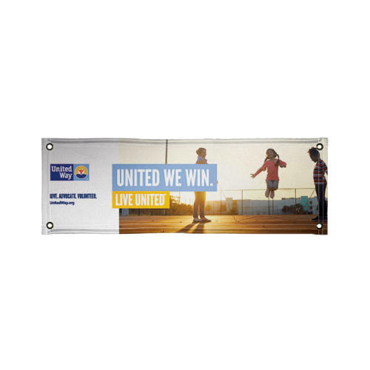
Because….
UNITED WE WIN (UWW)

