Slide 1
GENENTECH Gives Back
April 2018

Slide 2
Our Mission
Pursuing groundbreaking science to discover and develop breakthrough medicines for people with serious and life-threatening conditions.
Science
Patients
People
Follow the science.
Act in the best interests of the patients we serve.
Foster a great place to work for our employees.
2

Slide 3
Our Charitable Contributions Help Advance Science, Support Patients, and our Communities
$53.7 Million
Total Charitable Contributions in 2017
$13.6 Million
$29.2 Million
$10.9 Million
Advance scientific
knowledge
Enhance health
outcomes
Strengthen local
communities
3
Notes:
The $53.7M for 2017 includes Corporate Giving, Genentech Foundation, and matching gifts. These are corporate dollars contributed for philanthropic purposes and do not include GATCF or co-pay assistance.
Breakdown
Corporate Giving $40.5M includes money toward:
Advancing Scientific Knowledge (including Futurelab)
Enhancing Health Outcomes (including Resilience Effect)
Strengthening Local Communities (including employee match of $4.5M, and a one-time disaster response donation to Puerto Rico hurricane relief and North Bay fire relief efforts of $1.3M)
Genentech Foundation $13.2M includes money toward:
Advancing Scientific Knowledge (career pathways for underserved transitional-aged youth and adults in growing sectors like biotechnology, scholarships, and workforce development programs)
Science Garage (Of note: In 2017, Genentech made a one-time contribution towards the construction of the Science Garage)

Slide 4
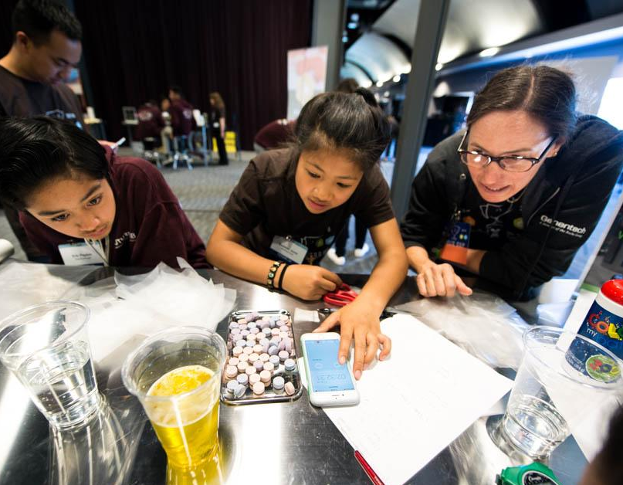
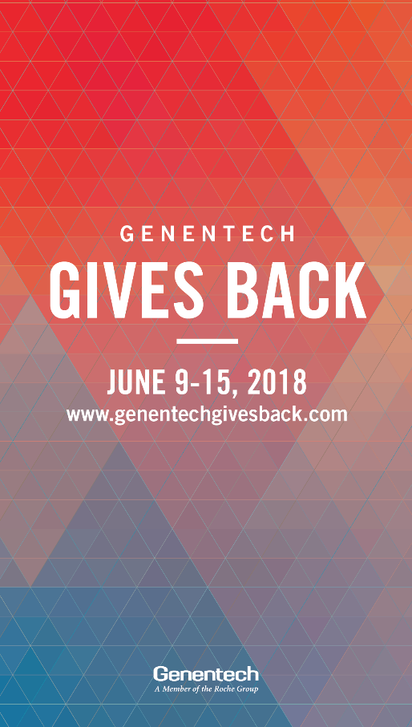
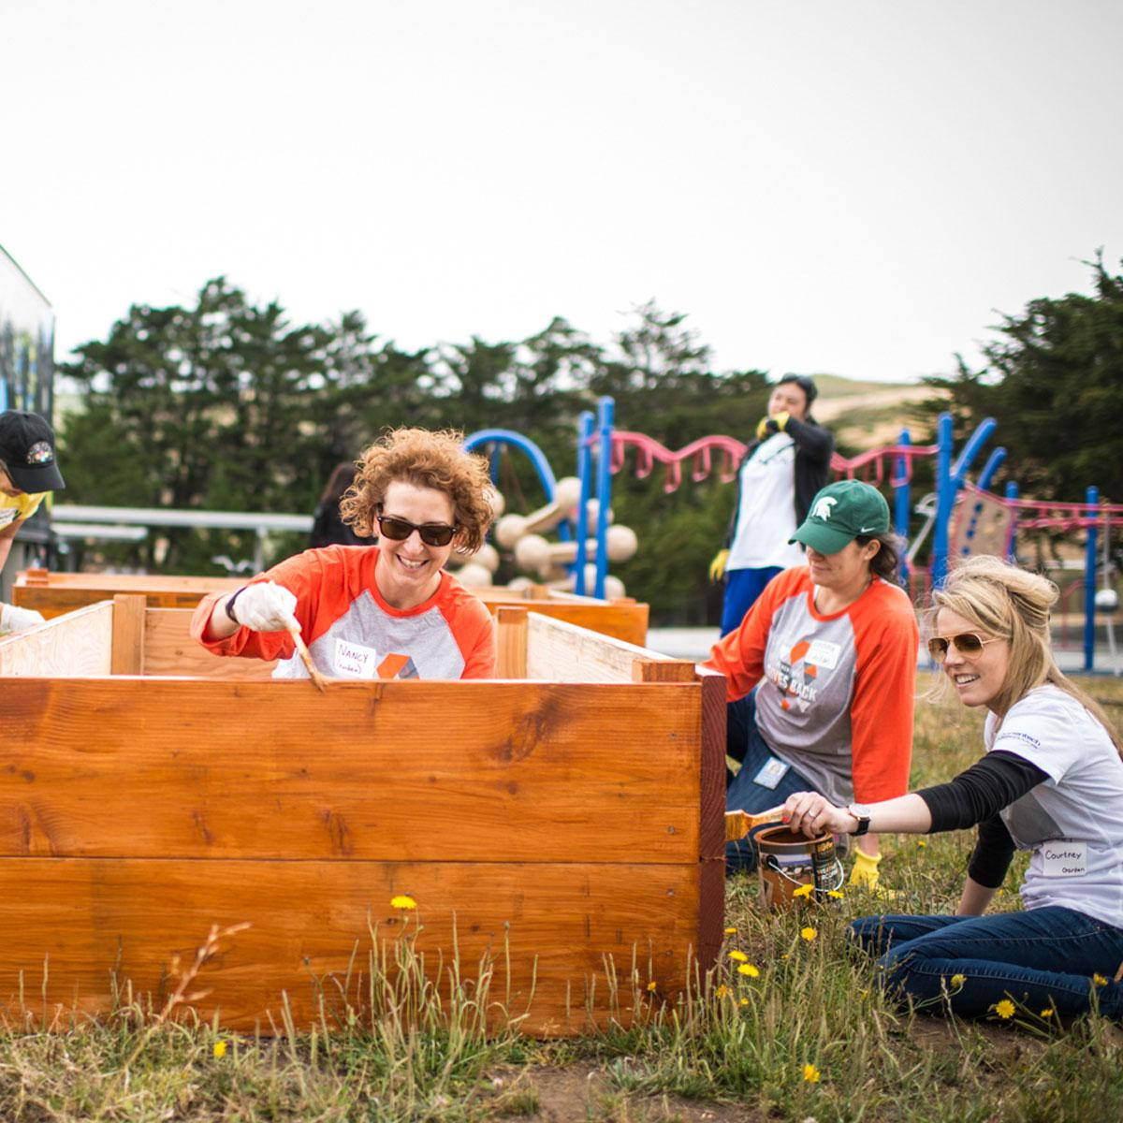
We Give Back Locally
We support local organizations, employee volunteerism, and create our own programs to meet the needs of the communities we serve.
We support local organizations, engage employees in volunteerism, and create our own programs to meet the needs of the communities we serve.
4
Notes:
Making a difference in the communities where we operate
Futurelab is Genentech’s program to provide hands-on science education to every K-12 student in the South San Francisco Unified School District (SSFUSD), with the ultimate vision of nurturing the next generation of scientists.
Through Futurelab and other giving back programs, Genentech provides employees with year-round, transformative volunteer opportunities that benefit our communities.

Slide 5
Our Employees Are Engaged in Giving
We support local organizations, employee volunteerism, and create our own programs to meet the needs of the communities we serve.
2017 Genentech Gives Back Week
5,100
Employees
$366,000
Dollars Raised
104
Non-Profits Benefited
1,500
Employees
28,000
Hours
9,000
Local SSF Students Engaged
2017 Futurelab
5

Slide 6
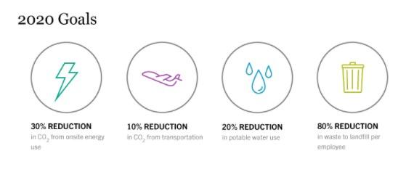
We Work Towards A Sustainable Future
We apply the same science-based approach to sustainability as we do to developing medicines. We are using cutting-edge technology to be a good steward of the resources we use and the space where we work.
We have met or exceeded our goals every year on sustainability and we recently announced a new set of 2020 goals:
6
Notes:
to reduce our absolute CO2 emissions by 30 percent from onsite energy use and by 10 percent from transportation sources, to reduce our absolute water use by 20 percent, and to reduce waste to landfill per employee by 80 percent, based on 2010 levels.

Slide 7
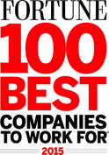
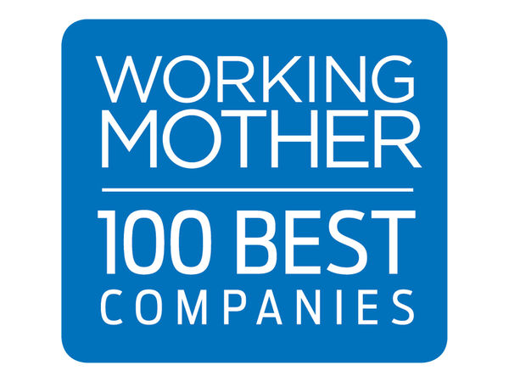
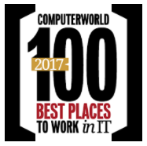
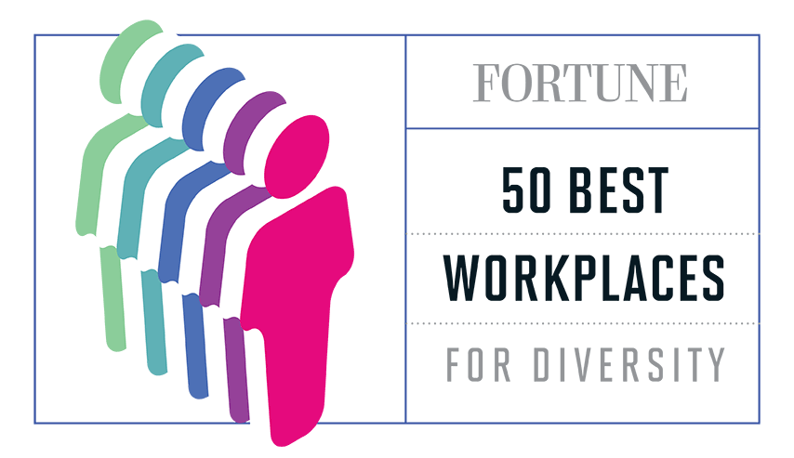
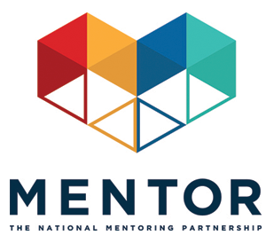
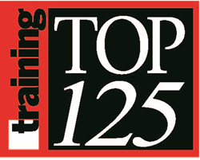
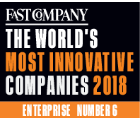
Great Place to Work – Top Employer Awards
20
years on the list
24
years on the list
6
years on the list
16
years on the list
2
years on the list
2
years on the list
11
years on the list
9
years on the list
12
years on the list
2
year on the list
3
years on the list
3
years on the list
2
years on the list
2
years on the list
2
years on the list
1
year on the list
1
year on the list
1
year on the list
Notes:
Mentor Award: National Corporate Mentoring Challenge Honor Roll
San Francisco Business Times Award: Corporate Philanthropy
Greatist Award: Healthiest Companies to Work For in America
Silicon Valley Business Journal Award: Corporate Philanthropy
Best Workplaces for Commuters (2018 list)
FAST COMPANY most innovative companies 2018 (Social Good category for Futurelab)

Slide 8
Civic Deserts: A Call for Volunteerism North County Philanthropy Council April 27, 2018

Slide 9
… examine the health of our American democracy.

Slide 10
“The cornerstone of democracy rests on the foundation of an educated electorate.”
~ Thomas Jefferson

Slide 11
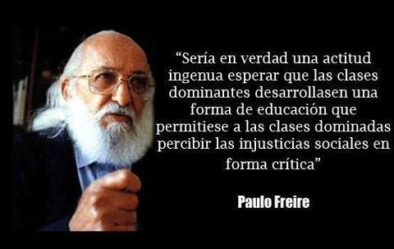
“Liberating education consists of acts of cognition, not transferals of information.”
~ Paulo Freire

Slide 12
America’s Civic Health Index
connecting to civic and religious groups;
trusting other people;
connecting to others through family and friends;
giving and volunteering;
staying informed;
understanding civics and politics;
participating in politics;
trusting and feeling connected to major institutions;
and expressing political views

Slide 14
Churches, unions, parties, newspapers:
Reach large numbers of Americans
Allow people to hear from others with diverse viewpoints
Magnify individuals’ power and voice
Autonomous, yet connect to government
Not primary purpose, but encourage civic engagement
Offer paths to leadership

Slide 15
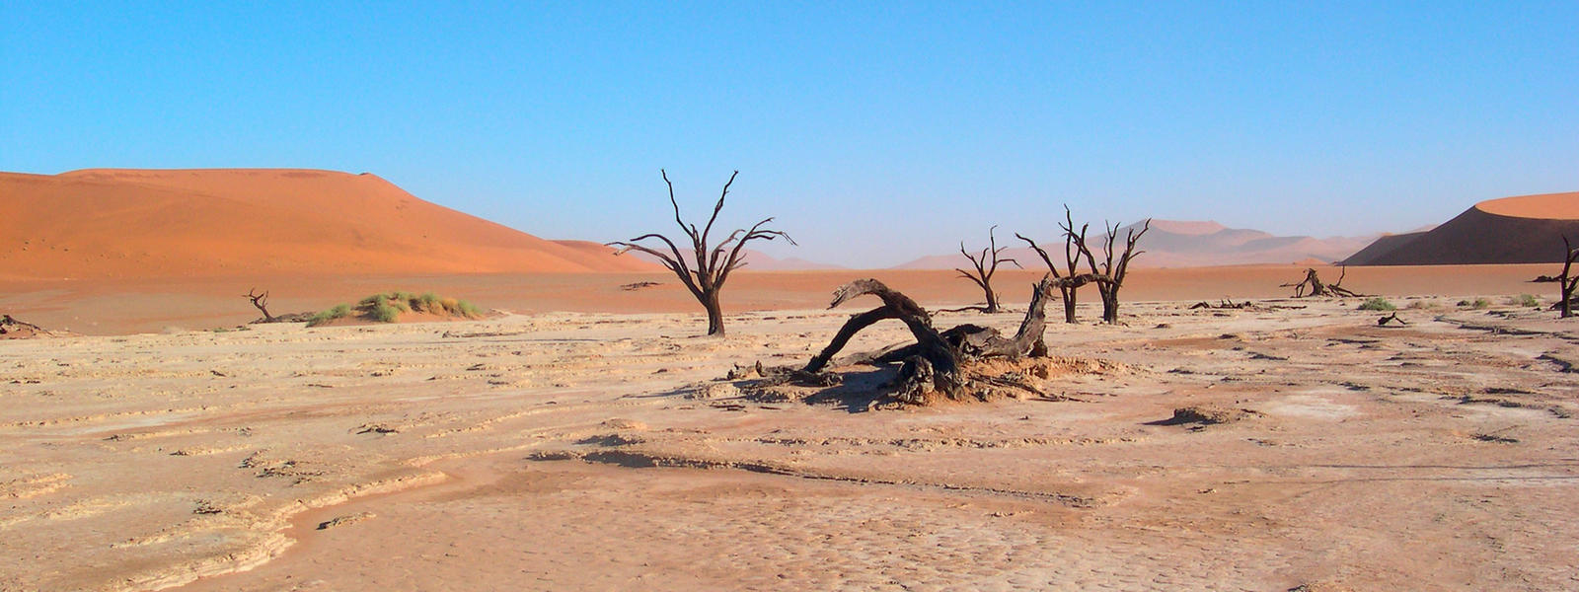
Civic Deserts
Places without adequate opportunities
for civic engagement

Slide 17
The College Experience
CURRICULAR Educational activity required by an academic course
Service Learning – doing community service as part of an academic course to deepen understanding of course content
CO-CURRICULAR Educational activity outside of the classroom
Days of Service (ie: Cesar Chavez Day of Service)
Volunteering (ie: regularly scheduled community service)

Slide 18
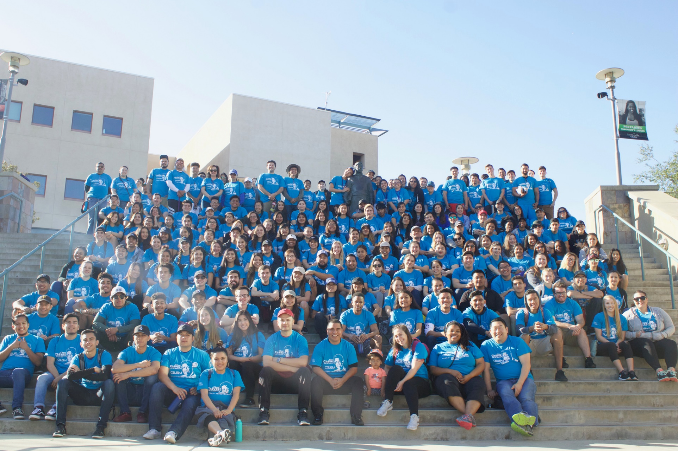

Slide 19
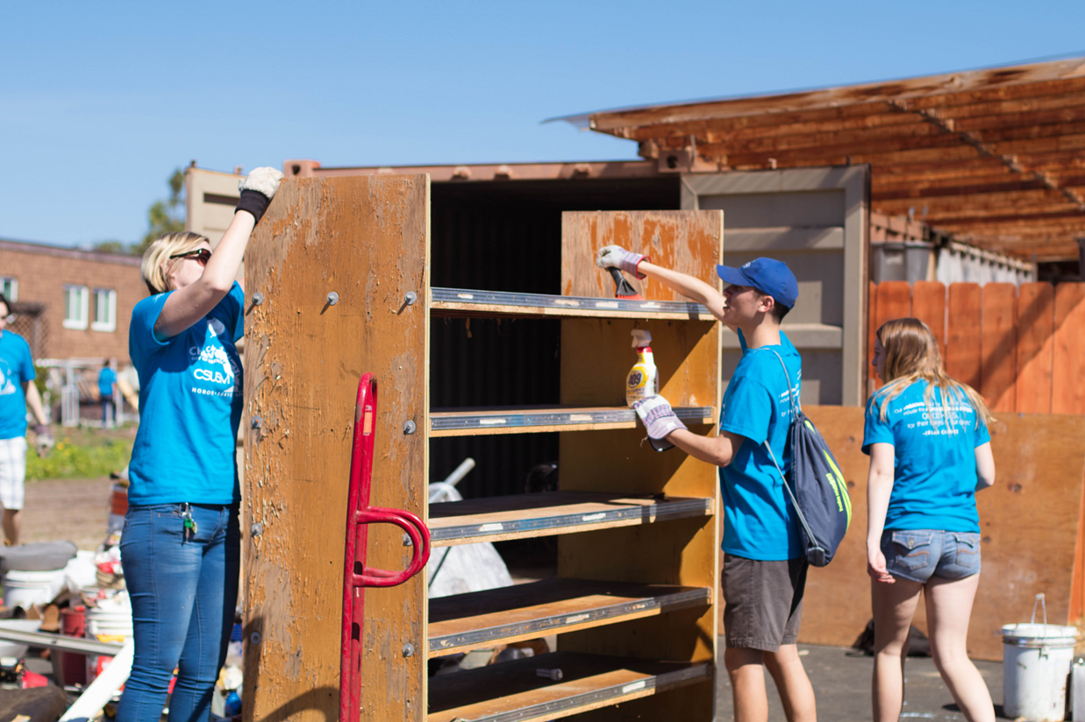

Slide 20
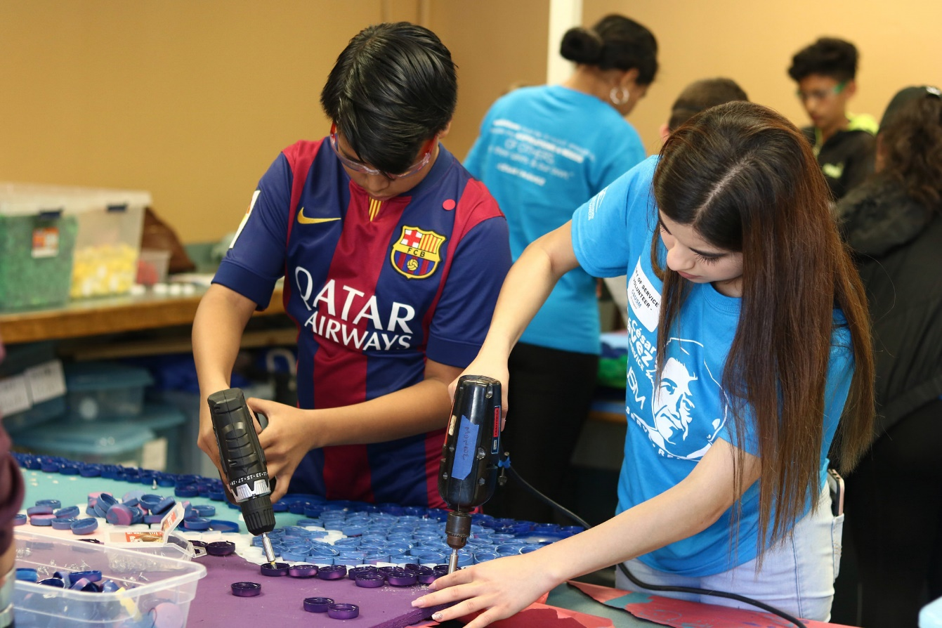

Slide 21
Cesar Chavez Day of Service
285 participants in 2017; 325 in 2018 = 14% increase
Women, Latinx populations are over-represented in our 2018 volunteer participant profile, compared to the general population.
96% of participants who responded to the survey indicated that they were more likely to participate in community service in the future as the result of this Day of Service
95% of participants say they are better able to recognize the value of equity and shared responsibility to and for one another as the result of this experience
92% of participants say they have a responsibility to use the knowledge they have gained at CSUSM to serve others

Slide 22
Civic Oases

Slide 23
Thank you!
Scott Gross
Associate Vice President, Community Engagement
sgross@csusm.edu
760-750-7000

Slide 24
north County Philanthropy Council
Creating a culture of giving

Slide 25
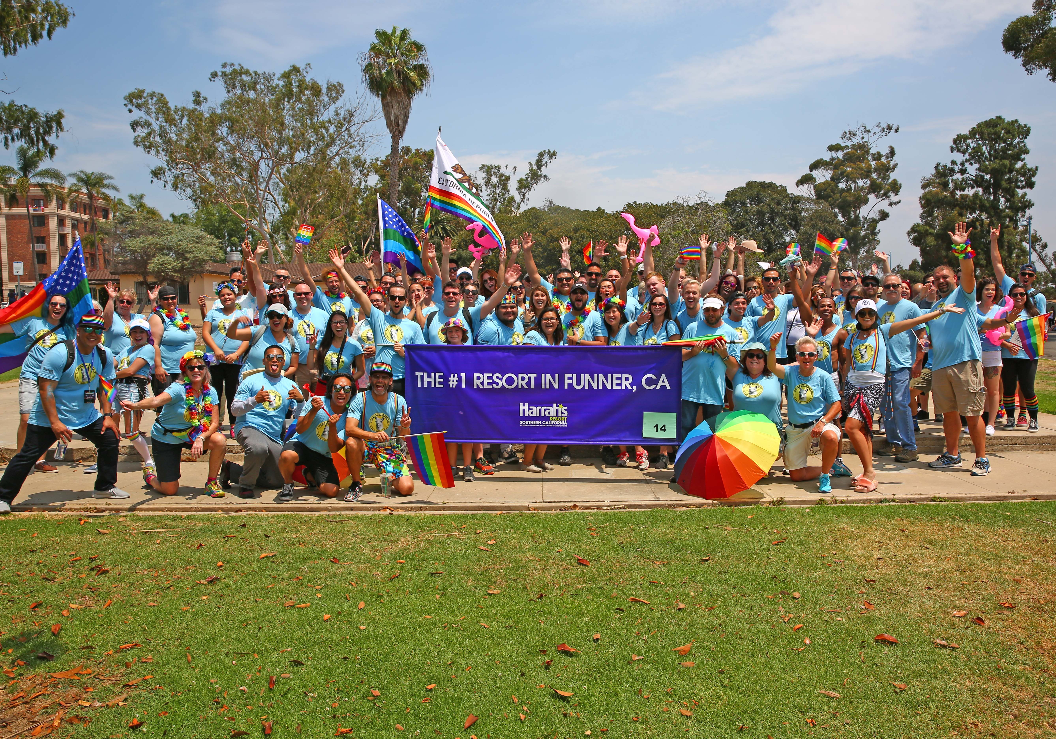
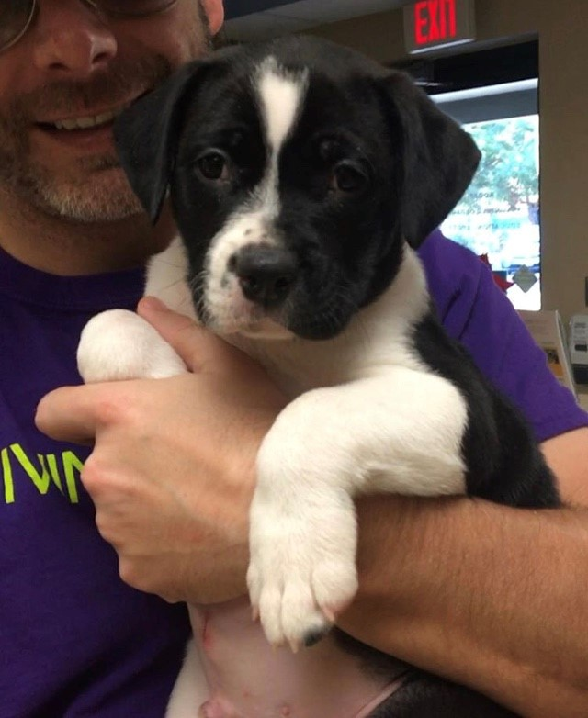
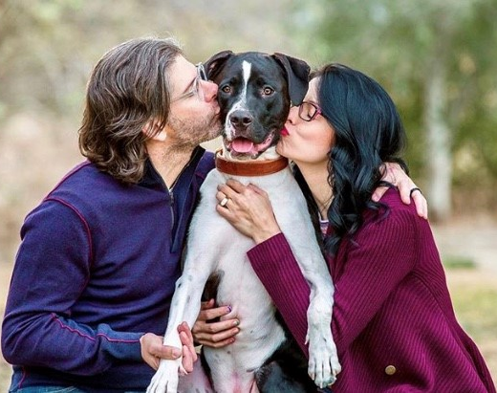
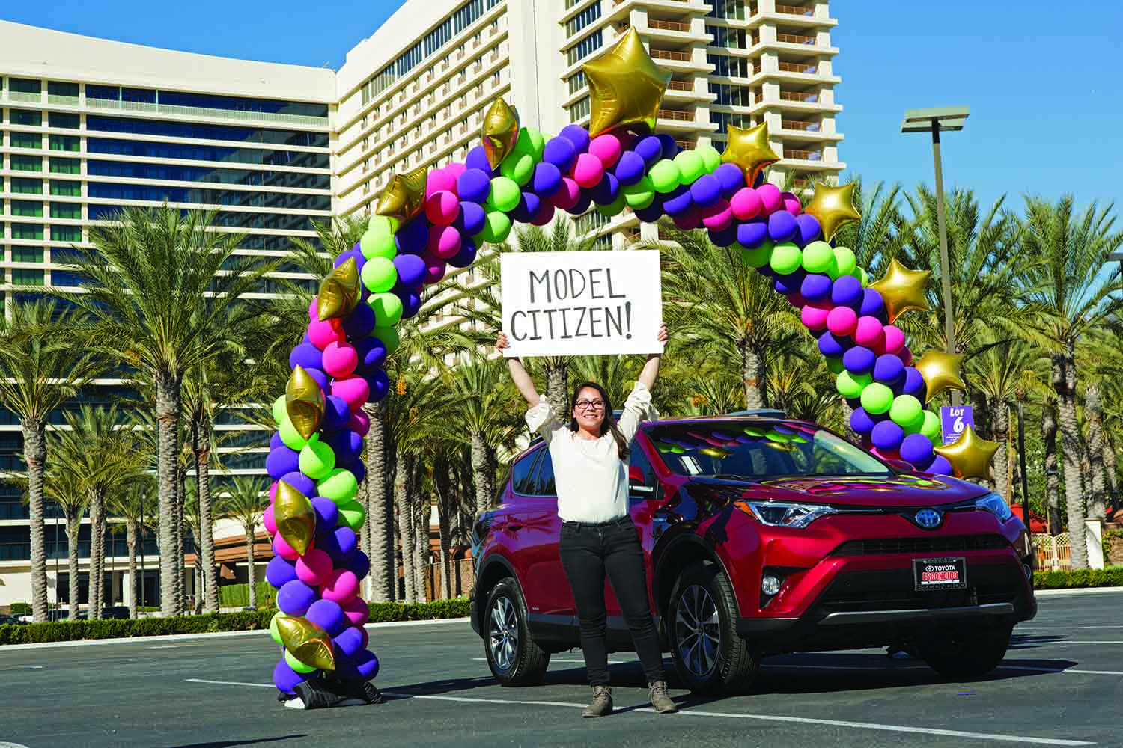
Giving Time – Blood, Sweat & Tears
Funner Model Citizen – a year-long incentive program aimed at encouraging volunteerism
700 teammates participated (out of ~1,600)
9,758 hours donated in 2017
40 monthly prizes awarded
2017 Model Citizen won a car
CodeGreen – 1st Place Q1 2018 (out of 36)
Giving Tuesday

Slide 26
Giving Talent – Board Work
Executive team representation on 501c3 boards
Broad and diverse representation/involvement
My current charitable work:
Tri-City Hospital Foundation – Board of Trustees
Jacobs & Cushman San Diego Food Bank – Board of Trustees
CSUSM – CoBA – Advisory Board
CSUSM – Athletics - Champions Council (Golf)

Slide 27
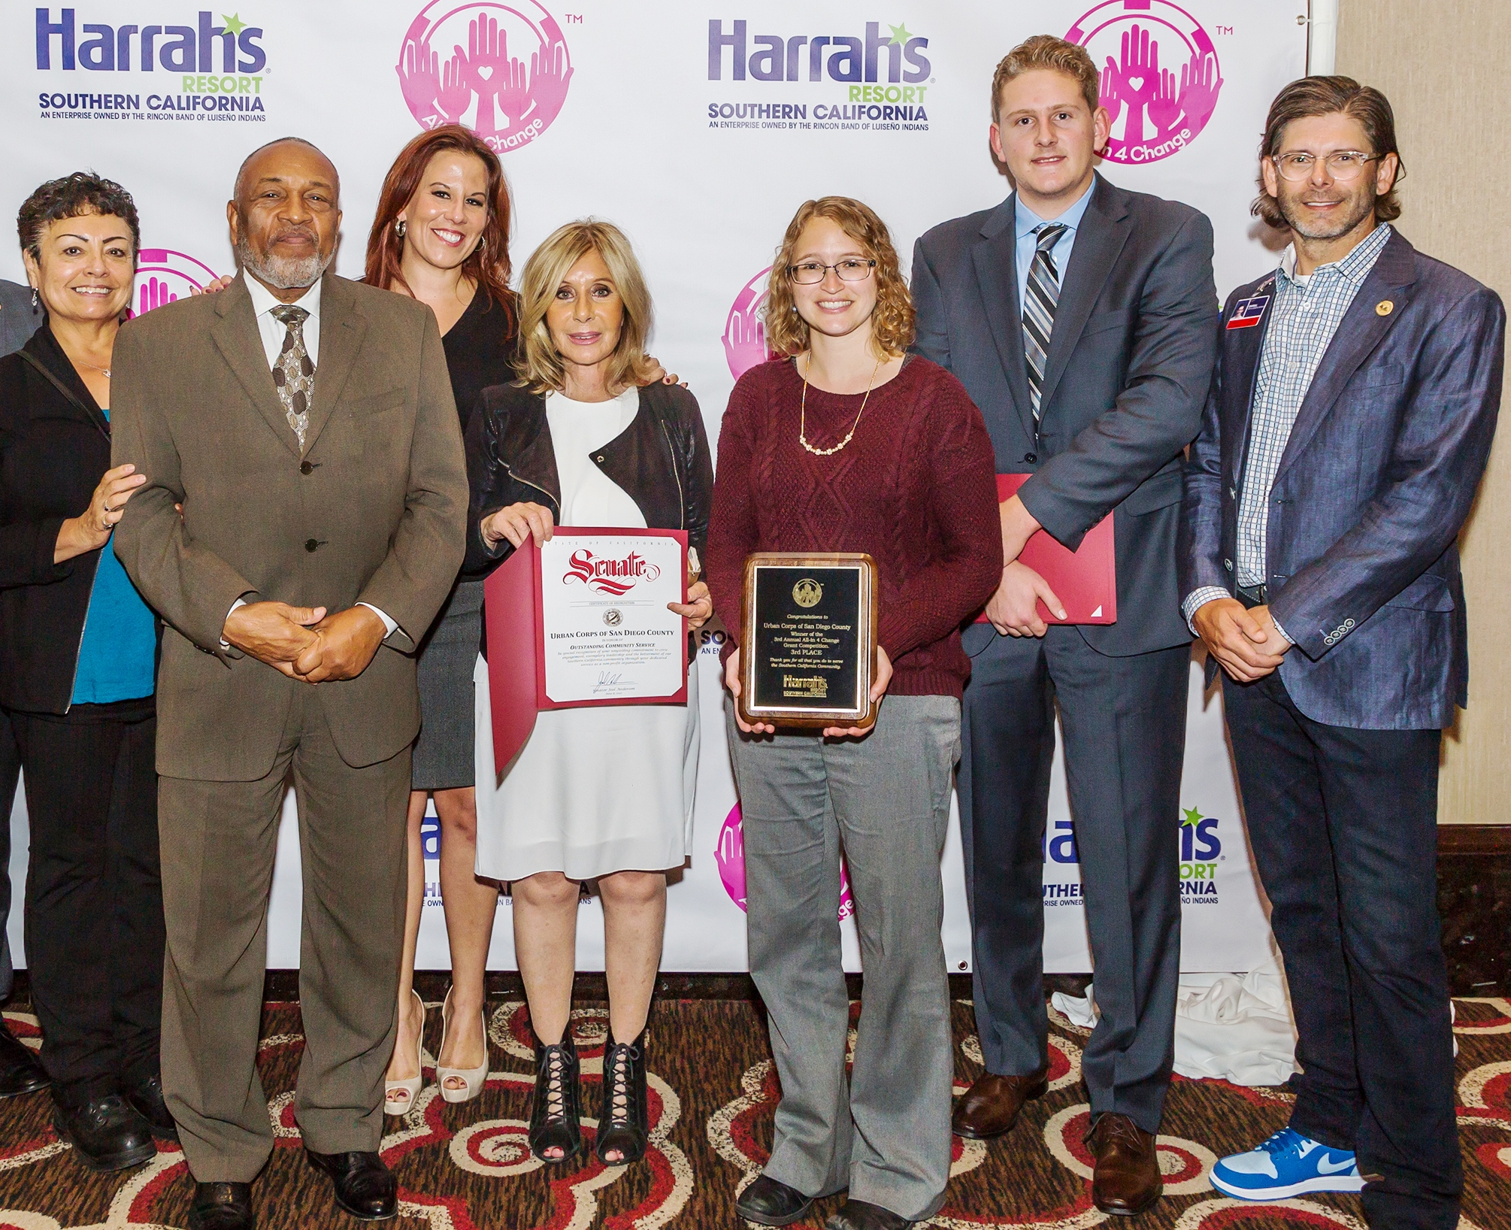
Giving Treasure – Putting Our $ Where Our Mouth Is
Cash & In-kind Donations
2017 = $330,195
2002 – 2017 = $3,550,683
2017 Relay for Life fundraising
Nine Caesars Vegas properties combined = $27,527
Harrah’s Resort SoCal = $27,899
2018 “All-in 4 Change” grant program
$150,000

